Slide 1
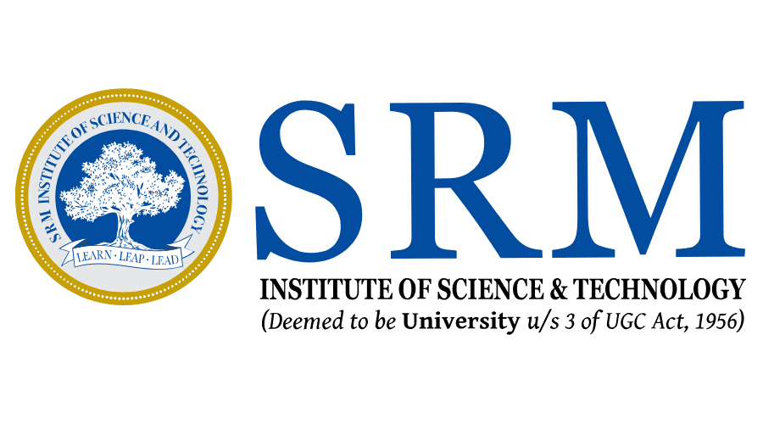
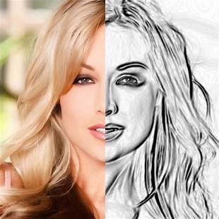
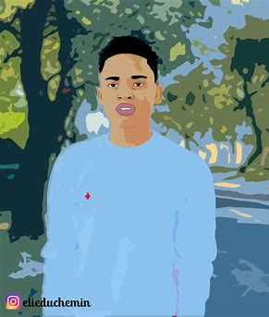
Cartoonify: Transforming Images with Machine Learning
SRM Institute of Science and Technology,
kattankulathur Campus, Chennai-89
DEPARTMENT OF DATA SCIENCE AND BUSINESS SYSTEM

Slide 2

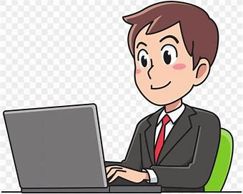

TEAM MEMBERS
SEYJUTI BANERJEE SAI TUSHAR VYSHNAVI NAGELLA
(RA2111027010052) (RA2111027010050) (RA2111027010034)

Slide 3
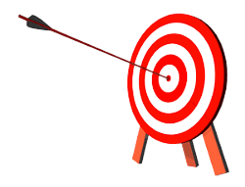
OBJECTIVE
The image cartoonification project seeks to merge the artistic appeal of cartoons with real-life photographs.
By employing machine learning techniques, the project aims to automatically transform images into delightful and playful cartoon-like renditions.
This endeavor not only enhances creative expression but also finds practical applications in entertainment, education, and marketing.
Empowering users with interactive control further enriches the overall experience, making cartoonification a versatile and engaging tool for visual storytelling and content creation.

Slide 4
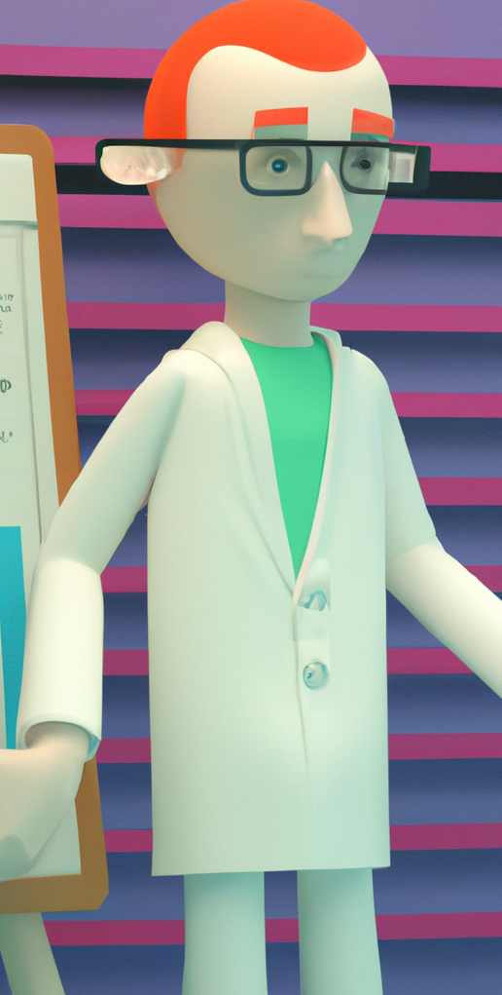
ABSTRACT
Machine learning, a pivotal facet of AI, employs data and algorithms to emulate human learning and enhance precision.
The focus is on Cartoonifying Images, achieved through a neural network that generates distinct cartoons from photos.
Python, particularly with OpenCV, serves as an alternative to web-based software such as Photoshop for this purpose.
The amalgamation of Python, OpenCV, numpy, and matplotlib produces a powerful application capable of transforming images into captivating cartoons.
This endeavor underscores the collaboration between machine learning and creative pursuits, highlighting their harmonious potential.

Slide 5

INTRODUCTION
Cartoons are commonly used in various kinds of applications. As we know cartoons are made artistically it requires elegant and fine human artistic skills.
Compared to sketching an image cartoonifying an image is efficient and quick.
Python programming language is used for writing a code to this technique And different python libraries are used to get most accurate output.
Mainly OpenCV,One of the library in python,is used in this method of cartoonifying.

Slide 6

SYSTEM REQUIREMENTS
Hardware Requirements
Processor: Minimum i3 Dual Core
Ethernet connection (LAN) OR a wireless adapter (Wi-Fi)
Hard Drive: Minimum 100 GB; Recommended 200 GB or more
Memory (RAM): Minimum 8 GB; Recommended 32 GB or above
Software Requirements:
Python
Anaconda
Jupyter Notebook
TensorFlow
opencv2

Slide 7

Literature survey - Paper 1
"Deep Cartoonification and Artistic Style Transfer"
Authors: H. Zhang, J. Zhang, and S. Liu.
Year: 2020
Advantages: Combines cartoonification with artistic style transfer, potentially creating unique and visually appealing results.
Disadvantages: Lack of specified year and potential limitations of the proposed technique.

Slide 8
Literature survey - Paper 2
"CartoonGAN: Generative Adversarial Networks for Photo Cartoonization"
Authors: J. Zhu, T. Park, P. Isola, and A. A. Efros.
Year: 2022.
Advantages: Uses GANs to generate cartoon-like images, allowing for diverse and customizable cartoonification.
Disadvantages: Potential challenges in controlling the level of abstraction and style fidelity.

Slide 9
Literature survey - Paper 3
"Towards Real-Time Photorealistic 3D Cartoon Rendering"
Authors: Y. Xu, L. Duan, Q. Zhao, and Q. Hou.
Year: 2019
Advantages: Focuses on real-time 3D cartoon rendering, enhancing realism and artistic expression.
Disadvantages: Lack of specified year and potential performance trade-offs.

Slide 10
Literature survey - Paper 4
"Image Cartoonization using Convolutional Neural Networks"
Authors: A. Al-Amir and M. Al-Maadeed.
Year: 2019.
Advantages: Utilizes CNNs for image cartoonization, enabling data-driven and automatic feature extraction.
Disadvantages: Possible challenges in handling diverse image styles and maintaining content fidelity.

Slide 11
Literature survey - Paper 5
"Cartoon-like Image Style Transfer"
Authors: D. R. Figueiredo, T. Simões, and J. L. Oliveira.
Year: 2017
Advantages: Explores image style transfer for cartoon-like effects, adding artistic flair to images.
Disadvantages: Lack of specified year and potential limitations in style transfer accuracy.

Slide 12
Literature survey - Paper 6
"Real-Time Artistic Style Transfer for Video"
Authors: S. Parisi, C. Shen, and A. Hertzmann.
Year: 2017.
Advantages: Addresses real-time style transfer for videos, offering dynamic and interactive cartoonification.
Disadvantages: Potential computational challenges for real-time processing.

Slide 13
Literature survey - Paper 7
"Adversarial Feature Learning for Style Consistent Image Generation"
Authors: Y. Liu, X. Li, and S. Osher.
Year: 2021.
Advantages: Focuses on style-consistent image generation using adversarial training, enhancing cartoonification accuracy.
Disadvantages: Potential complexities in adversarial training and model convergence.

Slide 14
Literature survey - Paper 8
"Cartoon Texture and Non-photorealistic Texture Synthesis and Transfer"
Authors: X. Yang, T. Xie, and Y. Jia.
Year: 2021
Advantages: Explores texture synthesis and transfer for cartoonification, adding detailed textures to cartoons.
Disadvantages: Lack of specified year and potential challenges in handling diverse textures.

Slide 15
Literature survey - Paper 9
"Artistic Style Transfer for Videos"
Authors: A. Ruder, A. Dosovitskiy, and T. Brox.
Year: 2016.
Advantages: Extends style transfer to videos, enabling dynamic and continuous cartoonification effects.
Disadvantages: Potential limitations in maintaining temporal coherence and efficiency.

Slide 16
Literature survey - Paper 10
"Neural Style Transfer: A Review"
Authors: A. A. Awan and M. A. Mahmood.
Year: 2021.
Advantages: Offers a comprehensive review of neural style transfer methods, providing insights into their application for cartoonification.
Disadvantages: Review may not cover the latest advancements and specific challenges in cartoonification.

Slide 17
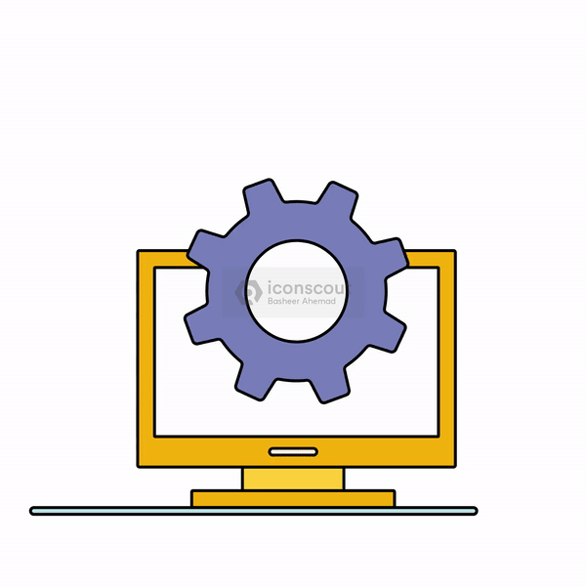
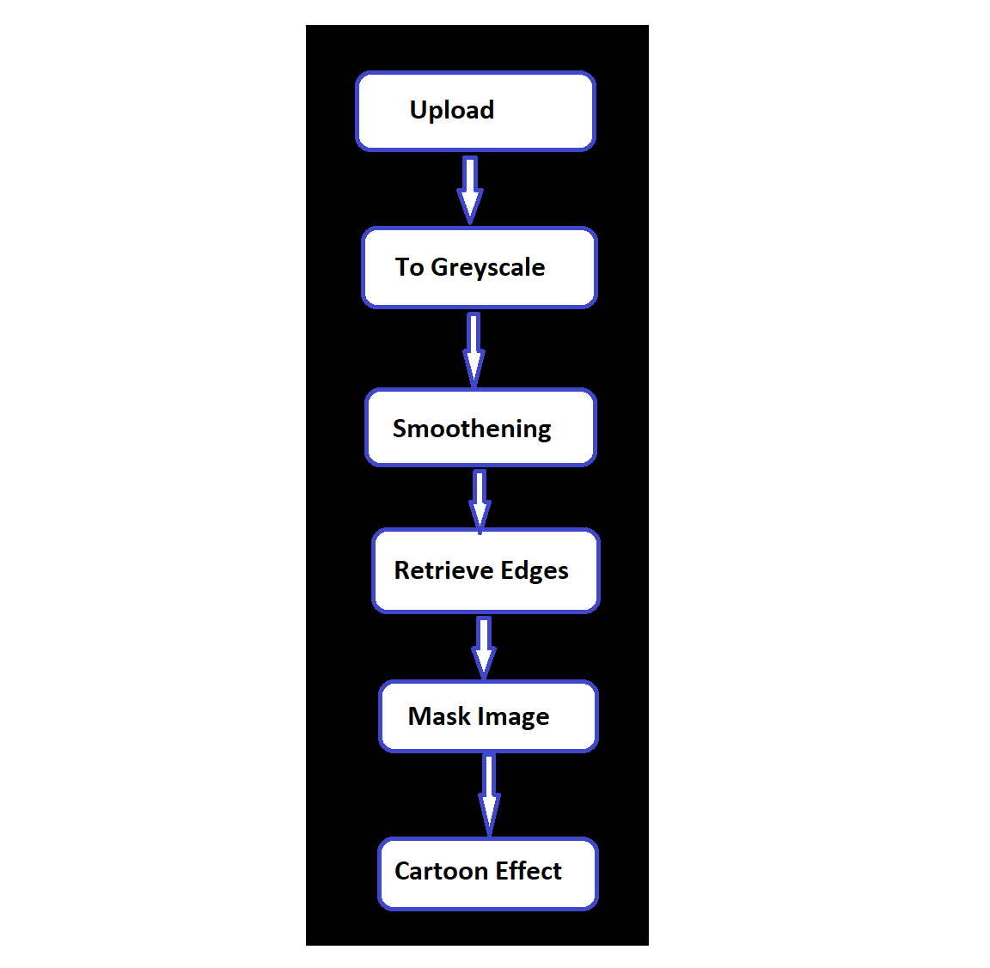
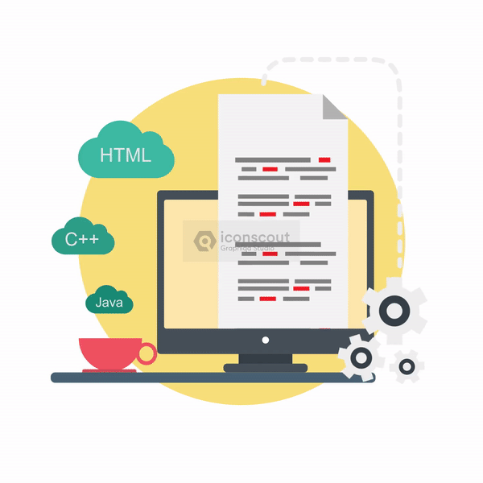
Architecture Diagram

Slide 18

ISSUES
There may be several issues that could arise during the development and deployment of the proposed project. Some of these issues could include:
Simplification can result in the loss of intricate details and textures present in the original image.
Edge detection algorithms might produce artifacts, leading to inaccuracies in outlining shapes.
The color simplification process can alter colors, causing unrealistic appearances in areas with subtle color changes.
Cartoonification can lead to an overly simplistic or "flat" look, lacking the original image's complexity.
Optional enhancements like exaggerated color boundaries may introduce unwanted artifacts.
Algorithm effectiveness can vary due to differences in image content, lighting, and complexity

Slide 19



ALGORITHM USED
Cartoonification Algorithm:
Combines several image processing techniques for a cartoon-like effect.
Edge Detection:
Utilizes Canny edge detection algorithm.
Identifies significant edges through gradient analysis.
The algorithm utilizes deep representation learning techniques, such as convolutional neural networks (CNNs) or recurrent neural networks (RNNs), to extract high-level features from the input data.

Slide 20
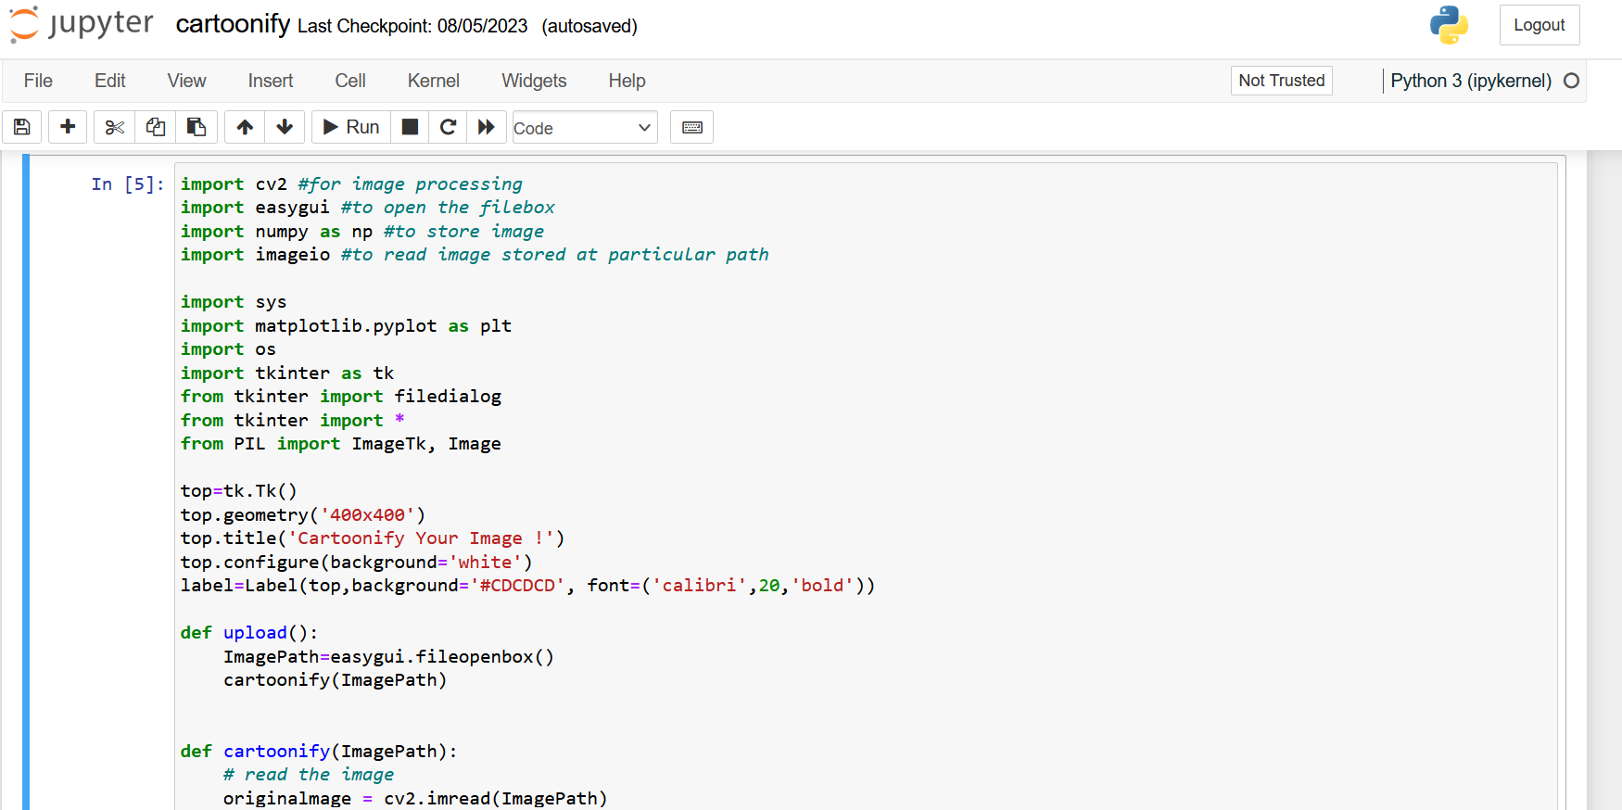
CODE

Slide 21
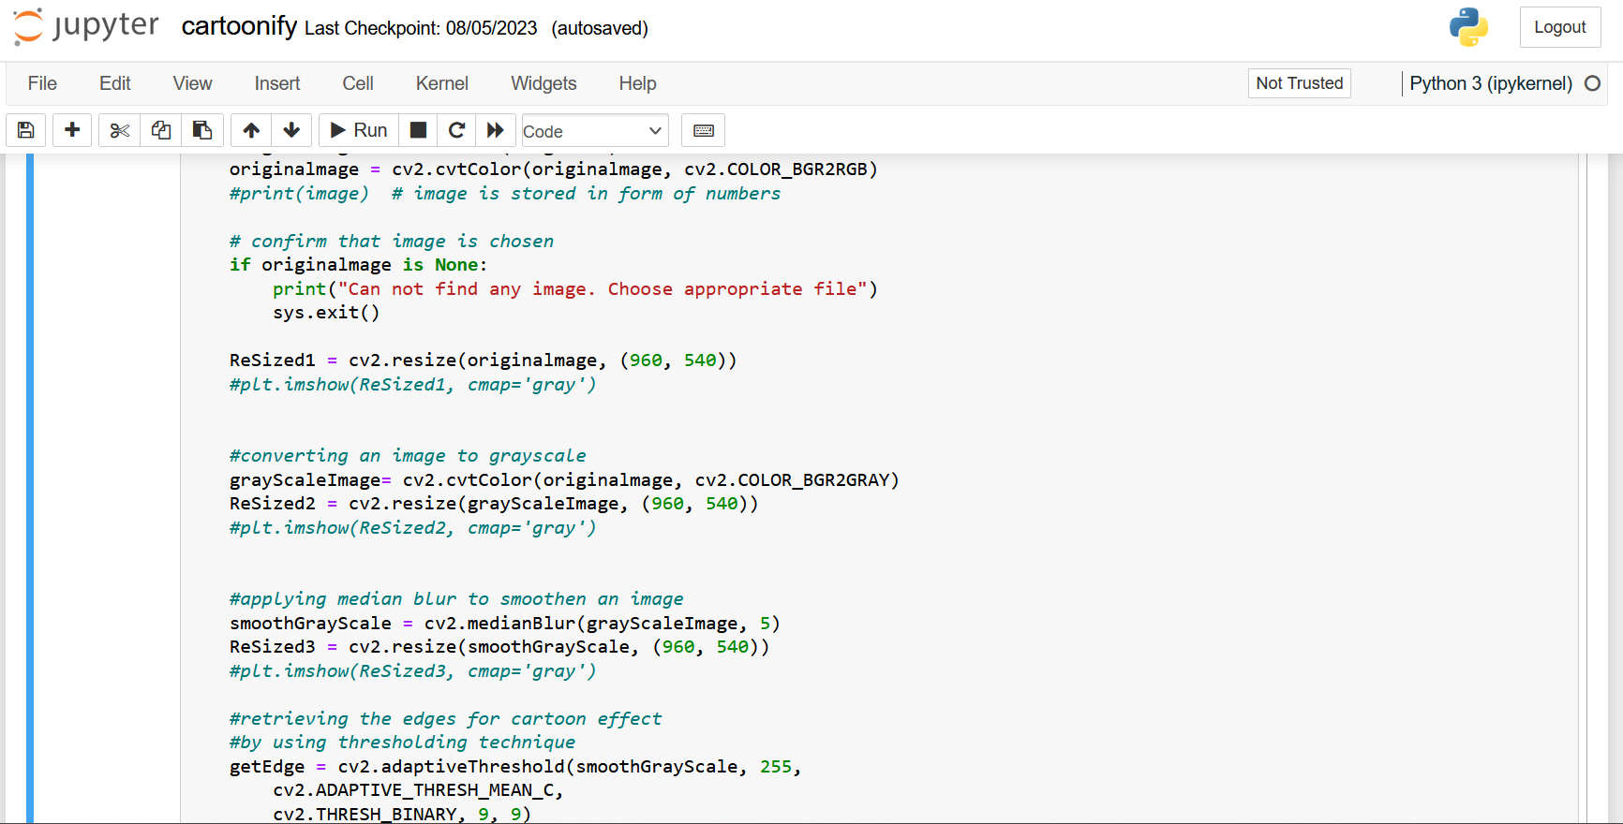

Slide 22
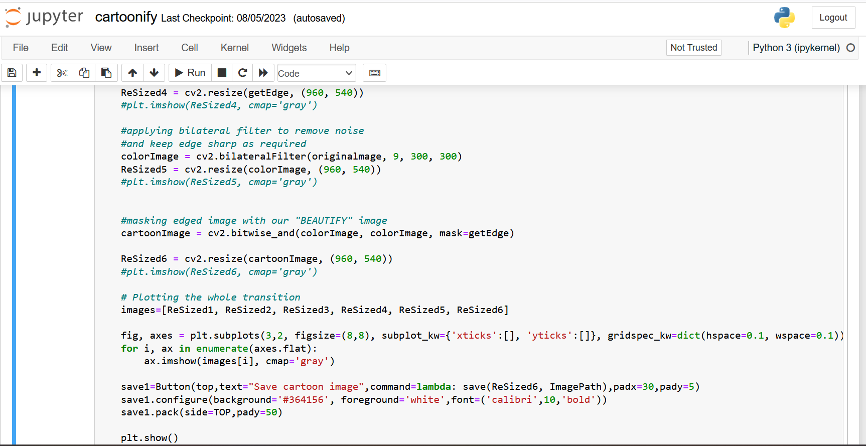

Slide 23
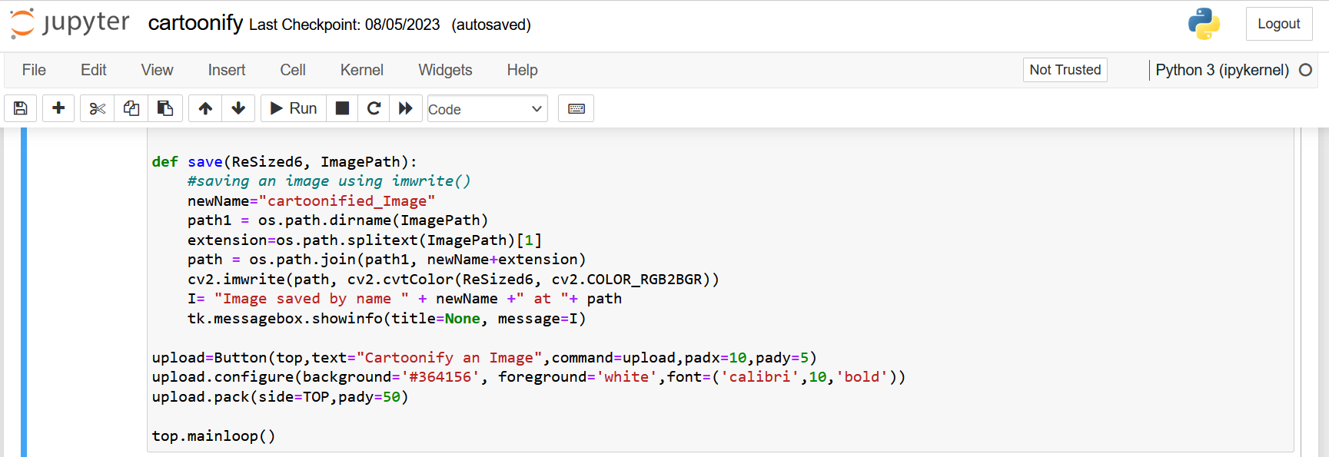

Slide 24
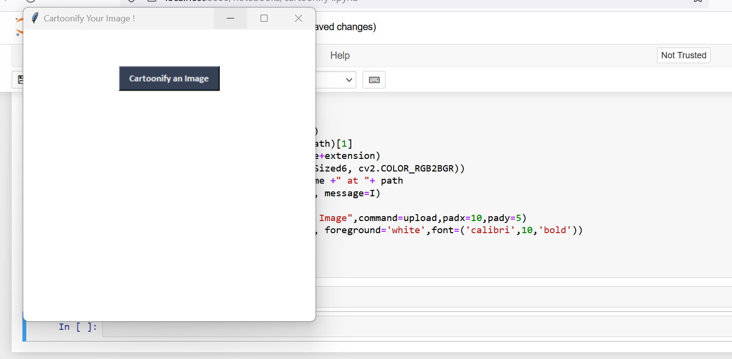
DISPLAY BOX

Slide 25
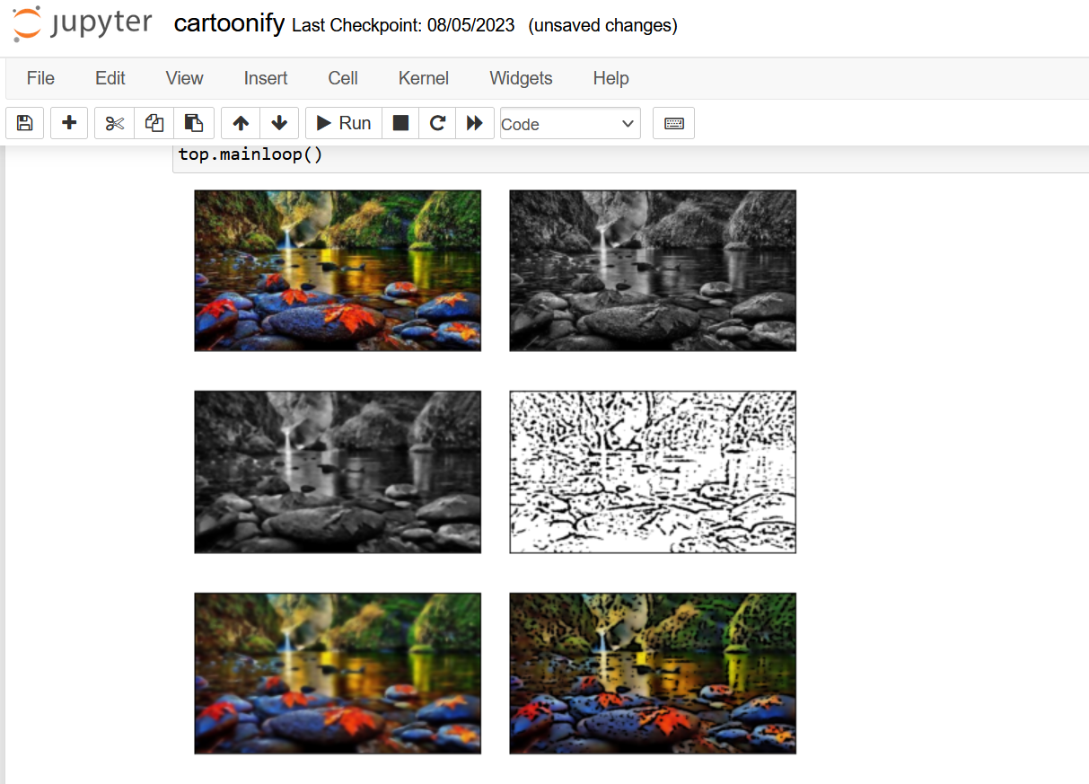
OUTPUT

Slide 26
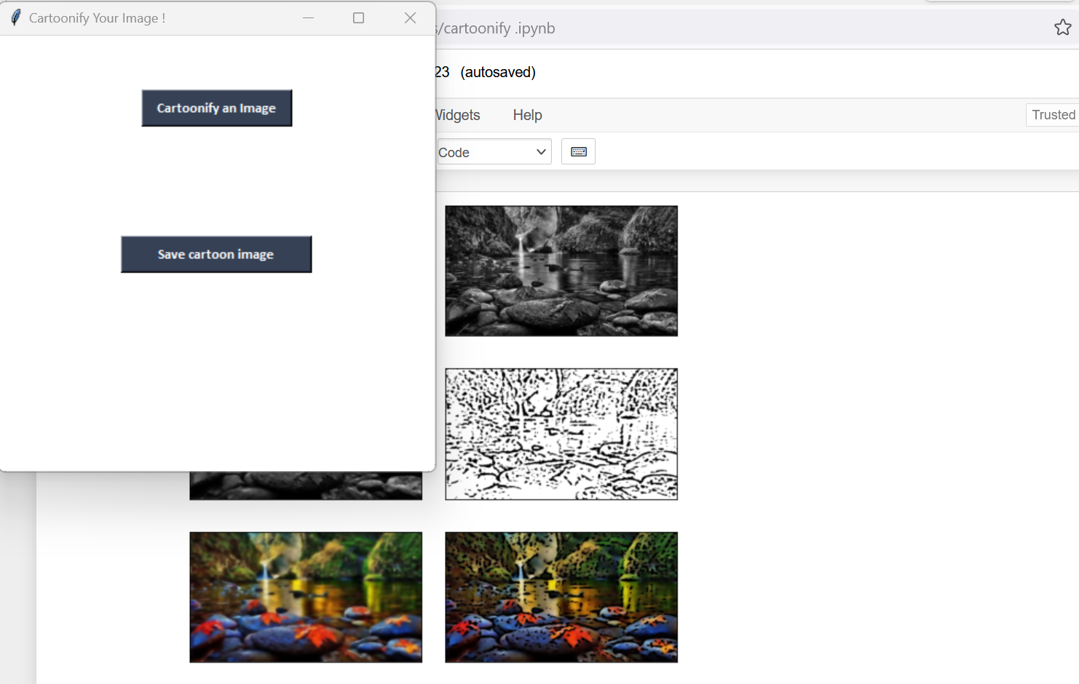
SAVING THE IMAGE

Slide 27
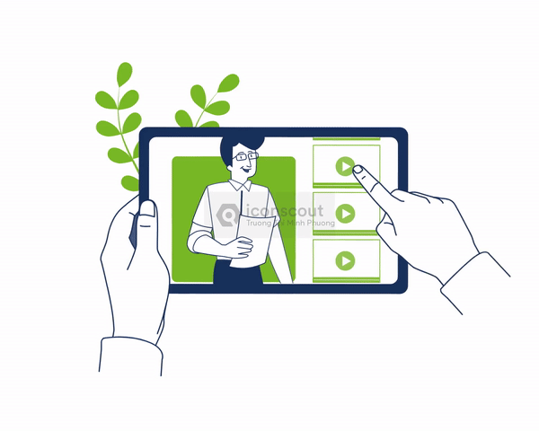

REFERENCES
MD.Salar Mohammad, Bollepalli Pranitha , Shivani Goud Pandula , Pulakanti Teja Sree : Object Detection
with Voice Sensor and Cartoonizing the Image. (August 2021)
Yugang Chen, Muchun Chen, Chaoyue Song, and Bingbing Ni : CartoonRenderer: An Instance-based MultiStyle Cartoon Image Translator.
Pranjal Singh Rajput, Kanya Satis, Sonnya Dellarosa, Wenxuan Huang, Obinna Agba : cGANs for Cartoon to
Real-life Images.
Yang Chen Yu-Kun Lai Yong-Jin Liu : CartoonGAN: Generative Adversarial Networks for Photo
Cartoonization.
Vaishali Sudarshan , Amritesh Singh :- Cartooning an Image Using Opencv and Python.(2020)

